Slide 1
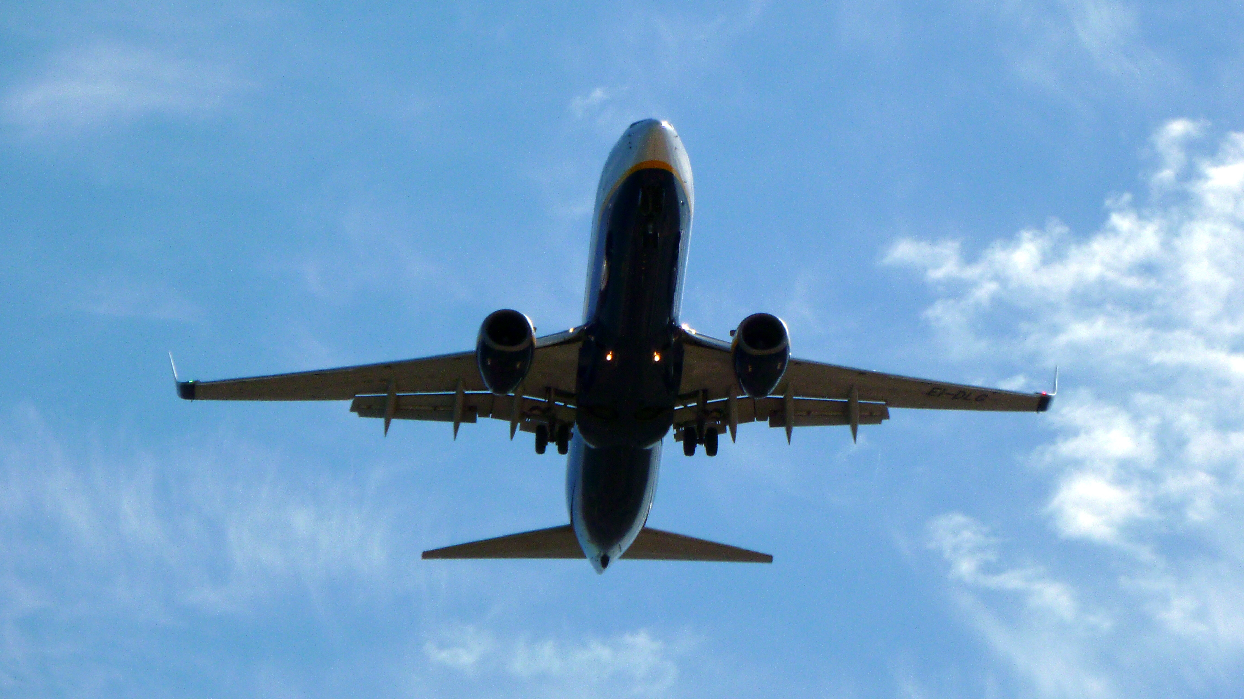
Data Visualization of Bird Strikes between 2000 – 2011

Slide 2
Introduction
Transport and communication are in the crucial domain in the field of analytics.
A bird strike is strictly defined as a collision between a bird and an aircraft which is in
flight or on a take-off or landing roll. The term is often expanded to cover other wildlife
strikes - with bats or ground animals.
To have a closer look the following document visually depicts
the data collected on Bird Strikes by FAA between 2000-2011.

Slide 3
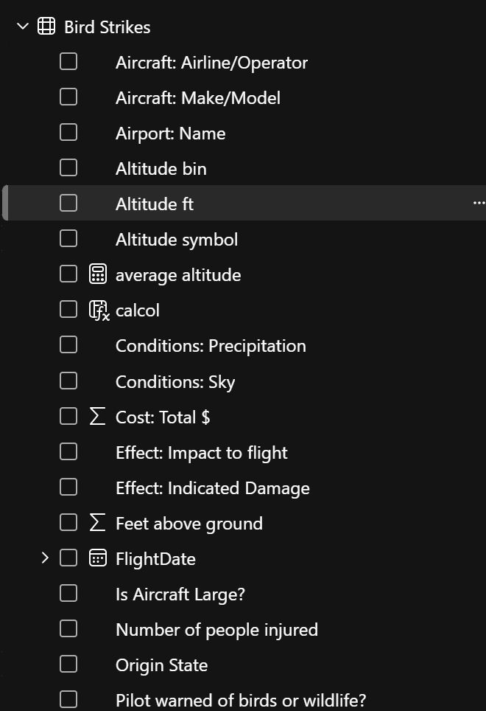
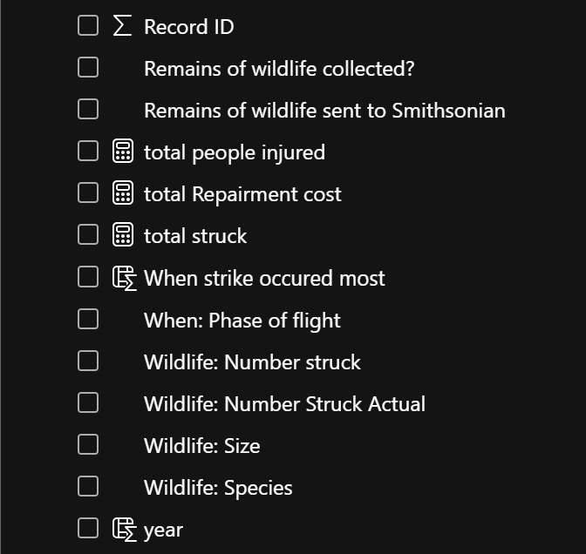
Details of Data

Slide 4
Main KPIs
To find the overall Trends of Bird Strike on the aircraft over Time
Impact on Flight during different phases of Flight, after the strike
To Identify the Airport that incur the most cost attributed to Bird Strike
To Find the Airports with most incidents of bird strikes – Top 50

Slide 5
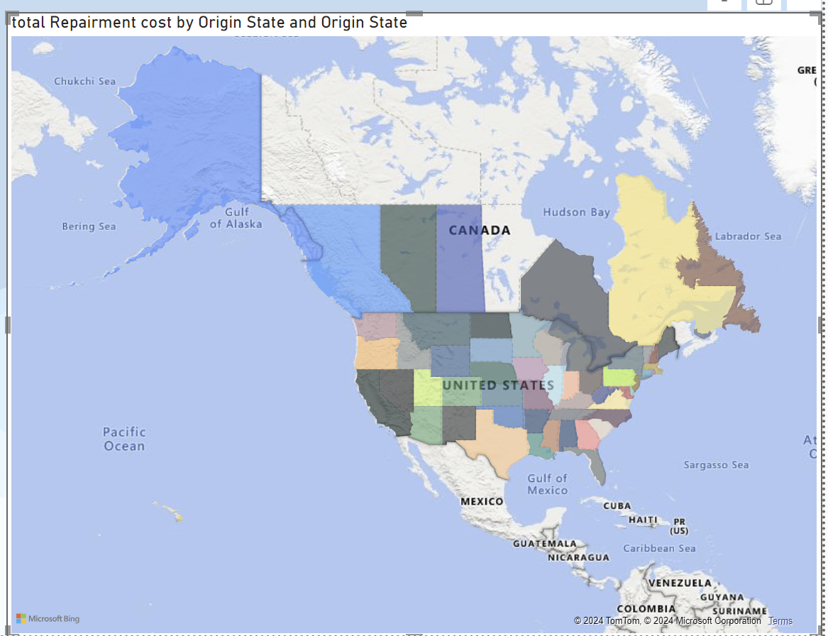
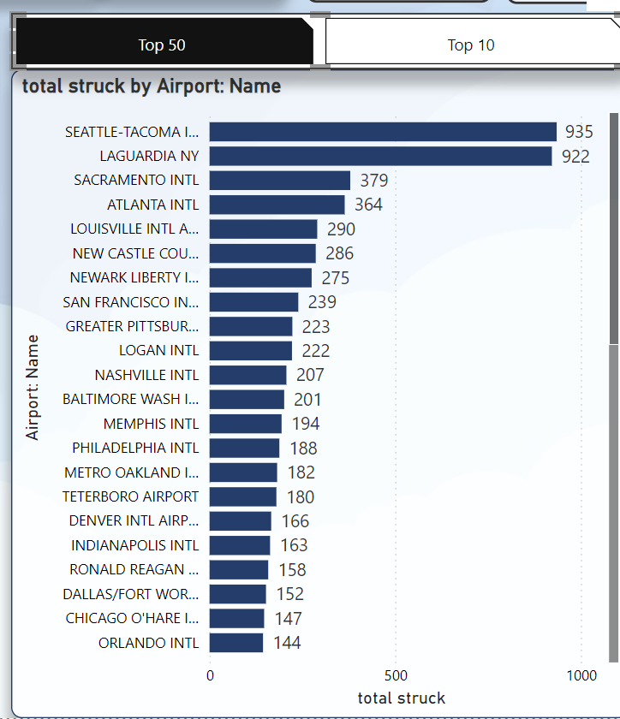
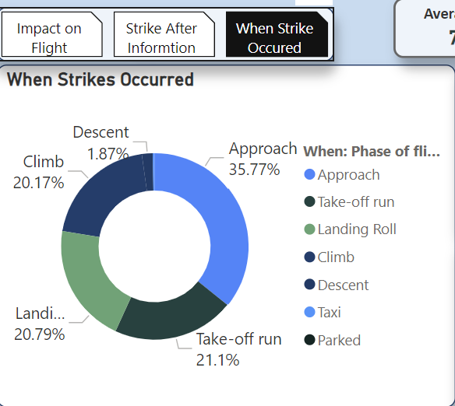
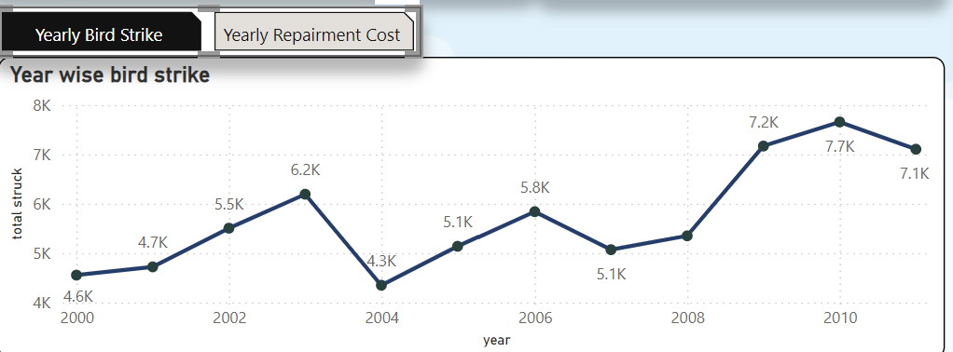
Mock – up Dashboard
To find top 50 Airport Name and Top 10 Airlines with most Bird Strikes
California is having the highest bird strike which is main reason of highest repairment cost
Upward trend seen in the last 6 years of Bird strike whereas Yearly Cost has a slight increase in the last 6 years
When most the Bird strike occurred when the flight Approach phase
43% Strike occurred after Pilot being informed and 57% occurred when pilot weren’t informed. The risk increased by 6%
Mostly Flights had no impact after the bird strike .4% had precautionary landing whereas less than 1% had engine Shutdown

Slide 6
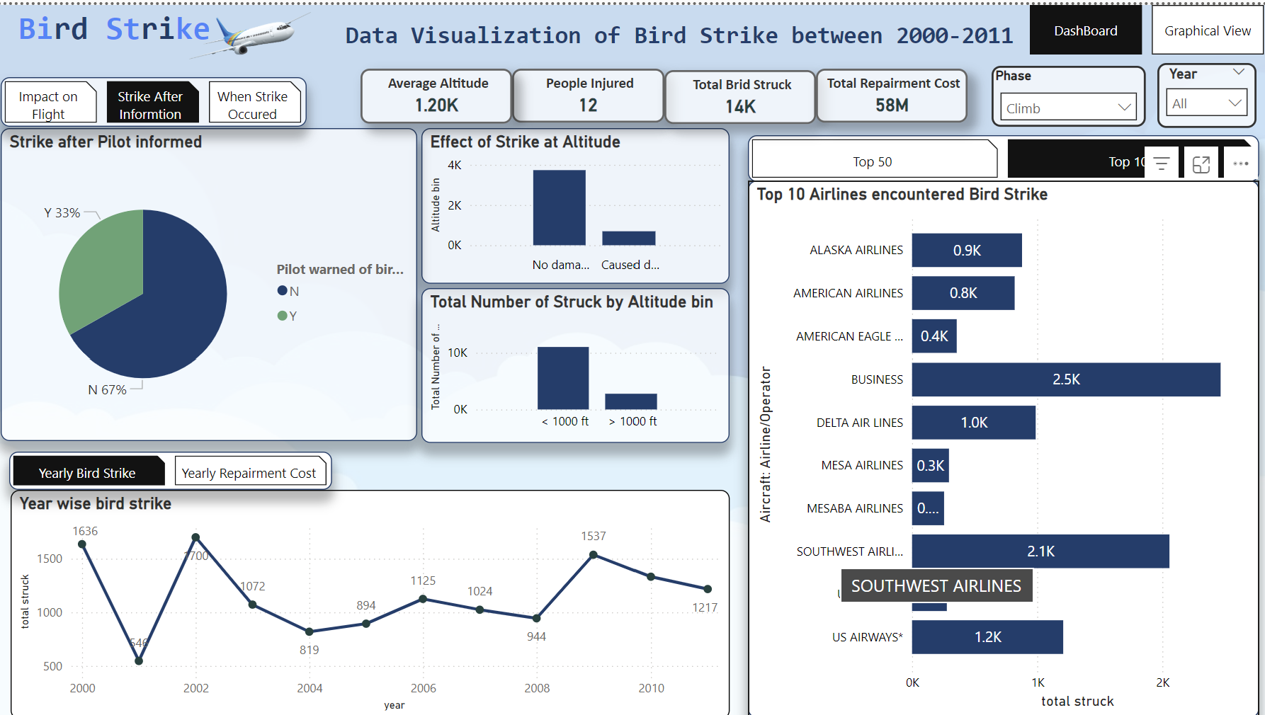
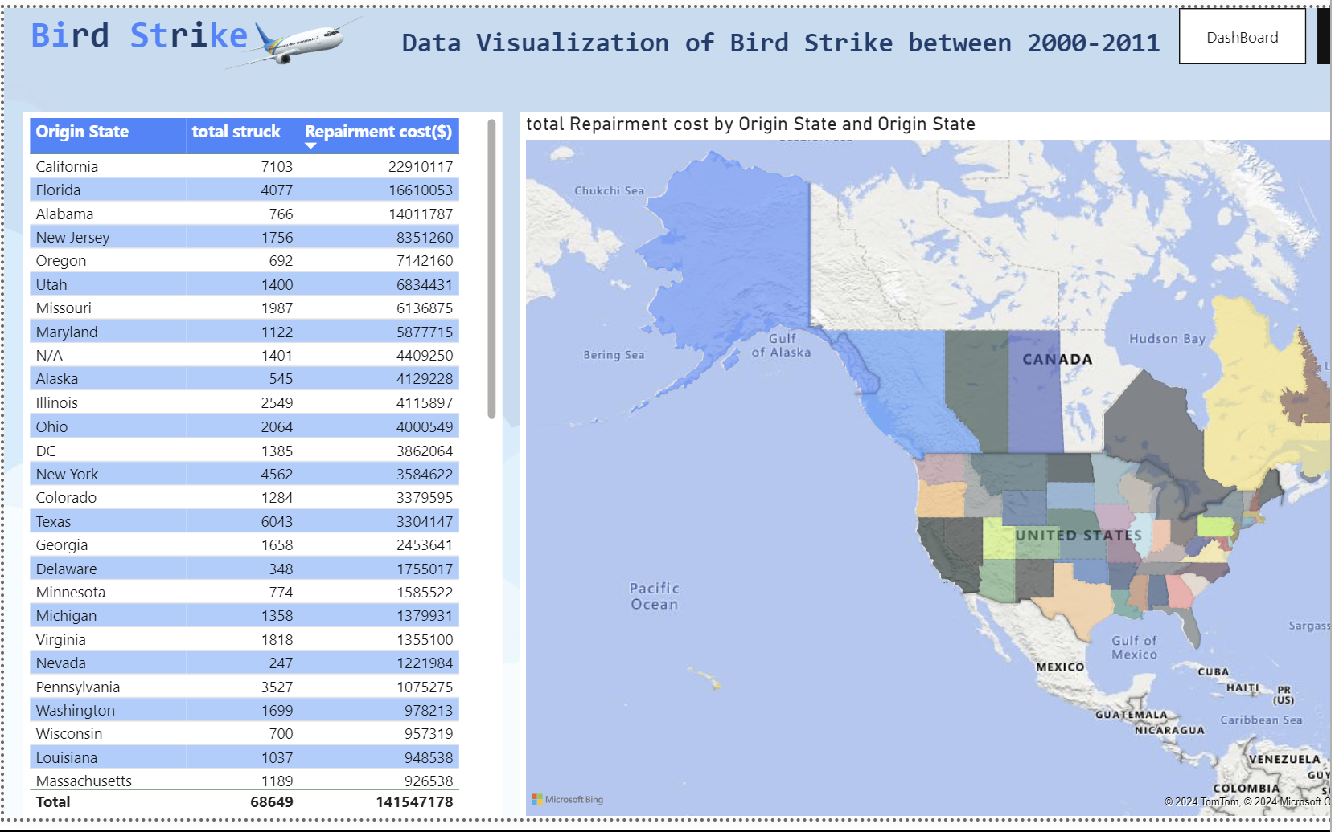
My Design

Slide 7
Thank you

